Slide 1
PHOTO DEDUPLICATOR
GROUP A

Slide 2
“The first rule of management is delegation. Don’t try and do everything yourself because you can’t.” — Anthea Turner

Slide 3
Agenda
01. Project methodology
02. Implementation team
We will discuss the pros and cons of waterfall and agile methodologies and give our reasons for our chosen methodology.
We will discuss three job roles essential to the implementation team to cover all aspects of the delivery.
03. Project Plan
04. Prototype
05. Testing & Deployment
We will show job roles and responsibilities for each job role throughout each of the development stages. We will also discuss specific features and business objectives.
We will show and demonstrate our protype and code while explaining the good coding practices used.
We will show create an an appropriate test environment to carry out tests and carry them out, recording all data in a test table. Then we will explain how this project can be deployed.

Slide 4
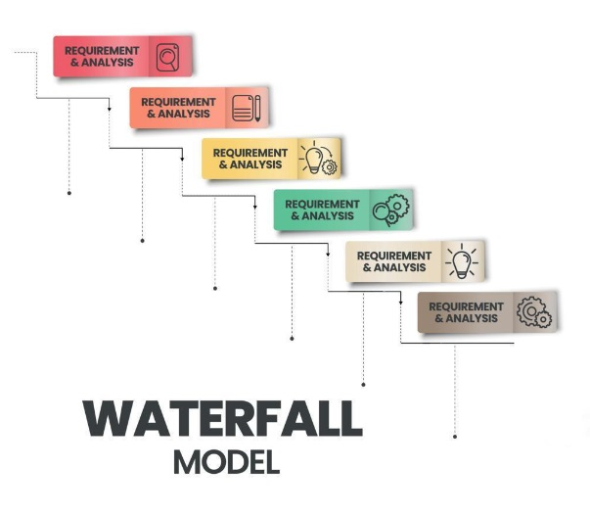
METHODOLOGIES
WATERFALL
PROS:
Clear structure with defined phases which makes it easy to understand and manage each stage
More accurate projection of time & cost
Easier to manage and efficient as it has well-defined requirements that will not change.
Each step is well documented ensuring that all team members are on the same page and requirements are clear.
CONS:
Less adaptable and can be costly if changes required
Testing late in the cycle could be costly if issues are found
Feedback comes in late leading to significant rework if requirements were not clear
Due to the sequential approach if any phase fails, it can jeopardize the project
Risks have to be identified and addressed during initial stages
Best suited for projects that have well defined requirements from start to finish. It is easy to manage however can lack flexibility. It gives predictability and structured documentation.

Slide 5
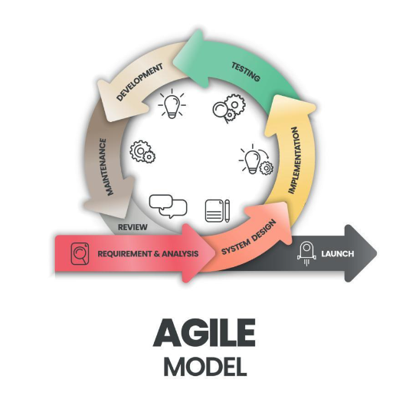
METHODOLOGIES
AGILE
PROS:
Flexible and adaptable allowing for changes even late in development
Regular feedback allows users to ensure product meets their needs
Offers better communication among team allowing for better problem solving
Early testing reduces risk of major issues down the line
After every cycle, teams engage and reflect on ways to enhance their efficiency
CONS:
- Could lead to scope creep - changes and additions could extend both timeline of project and costs
- Requires constant involvement from team members and customers which can be time- consuming
Harder to predict timeline and costs to project that could lead to poor decision making
Great for projects that may need to evolve and feedback is required throughout the process. It is flexible and can be continuously improved with fast delivery. It can suffer from scope creep.

Slide 6
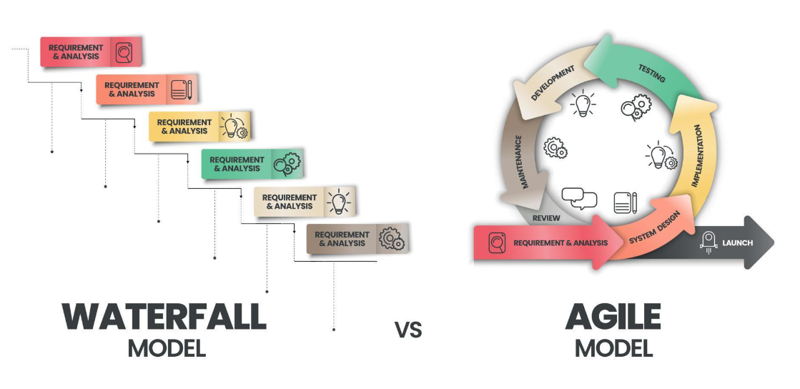
METHODOLOGIES
Our chosen methodology: AGILE
We have chosen the Agile Methodology for our Photo DeDuplicator project due to its flexibility and continuous feedback that can be obtained throughout all stages including the earlier testing stages. It has also allowed us to make any required changes throughout the development and will allow for any evolving features in the future.

Slide 7
IMPLEMENTATION TEAM
Lead Developer
Product Owner
QA Engineer
Responsible for coding, integration and testing.
Ensures best coding practices and coding standards.
Manages development team, assigns tasks and ensures project meets requirements
Acts as voice of the customer
Defines product requirements, and user stories.
Meets with other team members to ensure quality and functionality meets customers expectations
Responsible for quality and reliability
Designs and runs test plans, test cases and test scripts.
Ensures product meets the specified quality standards.

Slide 8
LEAD DEVELOPER
JOB DESCRIPTION
Ensure adherence to best coding practices and standards
Design and develop high quality code
Collaborate with other team members/departments to define project requirements and deliver updates throughout the process
Fix bugs and issues when and if required
Create and update documentation to ensure it is up to date
Proficiency in the relevant programming languages (e.g., HTML, Python, CSS)
Have a strong understanding of software development methodologies (e.g., Agile, Waterfall, Scrum)
Strong communication and interpersonal abilities
Problem-solving and critical-thinking skills
Expertise in system architecture and design patterns.

Slide 9
PROJECT MANAGER
JOB DESCRIPTION
Have a strong understanding of software development methodologies and processes
Be proficient in using product management systems (JIRA, Trello)
Strong leadership and decision making skills
Excellent communicator and analytical thinker
Communicate with team members, ensuring sufficient progress is being made and making informed adjustments when necessary tecture and design patterns.
Define the product vision and strategy and ensure it aligns with the business' goals and objectives
Create and manage product requirements and user stories
Gather requirements from stakeholders/customers and ensure all departments understand these requirements
Take the lead over review meetings and sprint planning meetings
Collect user feedback and use it to improve the product

Slide 10
QA ENGINEER
JOB DESCRIPTION
Develop test plans and strategies and define the test objectives and criteria
Write detailed test cases that cover all functional and non-functional requirements
Execute manual tests to identify bugs and issues and then document and report the findings
Conduct performance, load and stress tests and report findings
Perform regression testing to ensure code changes do not create new defects
Set up and maintain test environments
Have a strong understanding of software development methodologies and processes
Be proficient in using product management systems (JIRA, Trello)
Detail-oriented with very strong analytical skills
Excellent communication and collaboration abilities
Problem- solving and critical- thinking skills
design patter.

Slide 11
DEVELOPMENT STAGES
DEVELOPMENT STAGES | DEVELOPMENT STAGES
ROLE | PLANNING | DESIGN AND DEVELOPMENT | TESTING AND IMPLEMENTATION | DEPLOYMENT | MONITORING AND UPDATE RELEASES
PROJECT MANAGER | Project Manager would provide detailed instructions for the planning, organizing, controlling, managing and reporting the project resources | PM would plan sprints, versions, and releases according to the Photo DeDuplicator project roadmap. PM would manage development iterations, organise the development events | PM would sync-up the development team, plan sprint increments | PM would coach the whole team, report on time/efforts and delivered features, remove obstructions for the team | The PM ensures efficient communication between the Product Owner and the other members of the team. Tasks would end when project goals and objectives are successfully completed, product is delivered
BUSINESS ANALYST | Analyses, communicates and documents the requirements, business needs and goals for the Photo DeDuplicator with stakeholders, developers and other participants | In design stage, BA’s tasks include eliciting, analysing and validating the detailed requirements of the project, creating and maintaining design artefacts (such as prototypes) and specifications. BA oversees the changes and hurdles that arise during design. In development phase, development process relates to the requirements created by the BA. BA would also monitor the progresses made | In testing, BA ensures that the final product meets the business requirements. In implementation phase, BA helps the technical team to resolve requirement related roadblocks | BA serves as the first point of contact for users when they face issues and provide feedbacks | BA coordinates the development team, organises future updates in the software or implements the required fixes
SOLUTIONS ARCHITECT | Tries to understand constraints of the project. Considers technical and business factors which align with the project goal | SA is responsible for ensuring all requirements are met during development and examine the limitations of the project to optimize alternatives, reduce risks | SA participates in making crucial technical decisions which impact project’s ultimate results (such as technology stack and integration with third-party systems) | Acts as the link between the technical team and the project manager | SA is responsible for the continuous maintenance of the product developed ensuring it works properly.

Slide 12
COMMITMENTS
FEATURES
BUSINESS OBJECTIVES
Application will have cross-platform compatibility- can be used with various operating systems Windows and macOS
The application will support a wide range of formats such as .png , .jpeg and .gif. The application must recognise all formats and spot duplicate within a folder
The application will have a user friendly interface that is easy to understand no matter the skillset of the user.
The team will communicate clearly and have good time-keeping skills
Saving storage space: the application will spot duplicate files so they can be deleted, freeing up storage space
Regular bug fixes and improvements will be made
Customer feedback will be implemented in the future to help improve the application
The project must be cost effective without sacrificing quality or functionality
The application should comply with relevant regulations regarding safeguarding, user data and security
There should be security measures within the application to protect the users sensitive data and the user’s system
The application should be able to handle big workloads without any effects on the performance

Slide 13
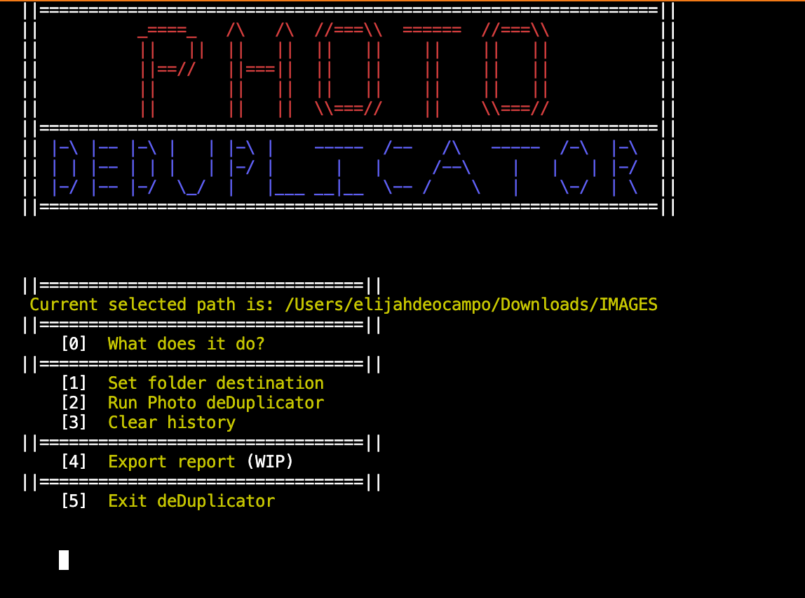
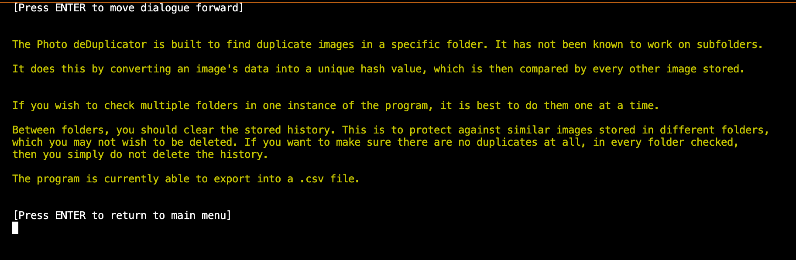
PROTOTYPE
This is the starting screen and main menu of the program. There are 5 options that the user can choose from that will all be explored in this section of our presentation.
If the user inputs option '0', it will lead them to the page above which offers information on the Photo De-duplicator application's functionalities and also how to use it correctly. After viewing this, they can press 'Enter' to return to the main menu.

Slide 14
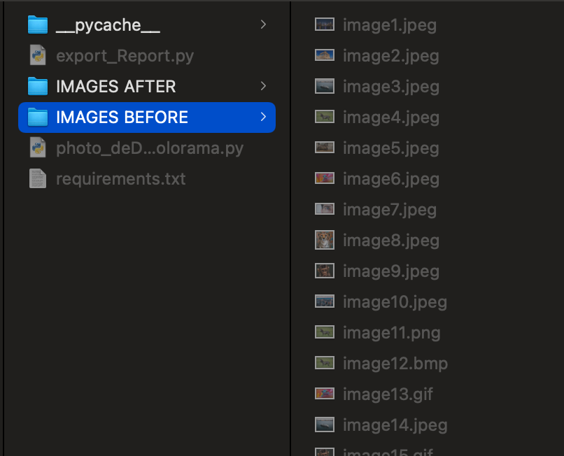
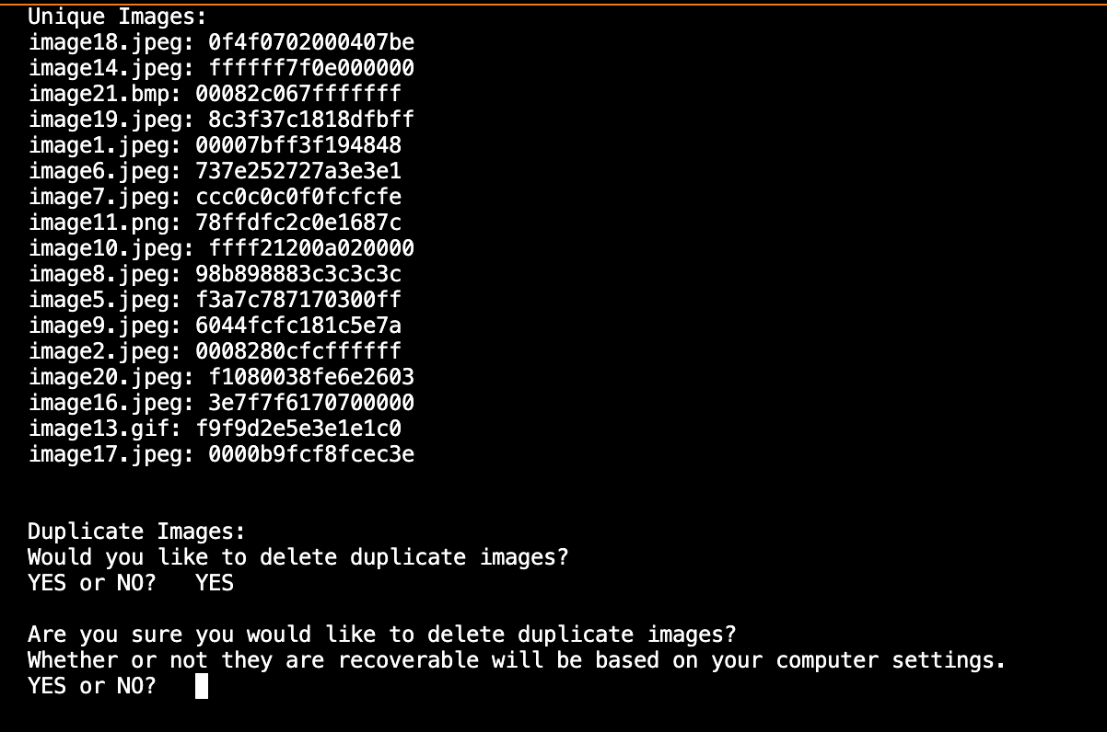
Option '1' in the main menu sets the folder destination that the program will run inside of. Once the user chooses this option, the user system's file manager will pop up to choose the folder that the user wants to select. In this case, it opens up the 'Finder' as this demonstration is being made on the macOS system.
After the folder is selected the destination of the folder will appear in the main menu above the options.
Option '2' in the main menu runs the De-duplicator code and created a list of all the images in the folder. It then creates a list of the duplicate images, regardless of their file types. It then asks the user if they want to delete any duplicate images. If they choose 'YES', a warning is given to verify if the user wants the duplicates deleted.

Slide 15
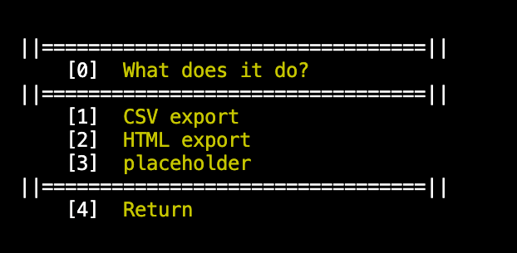
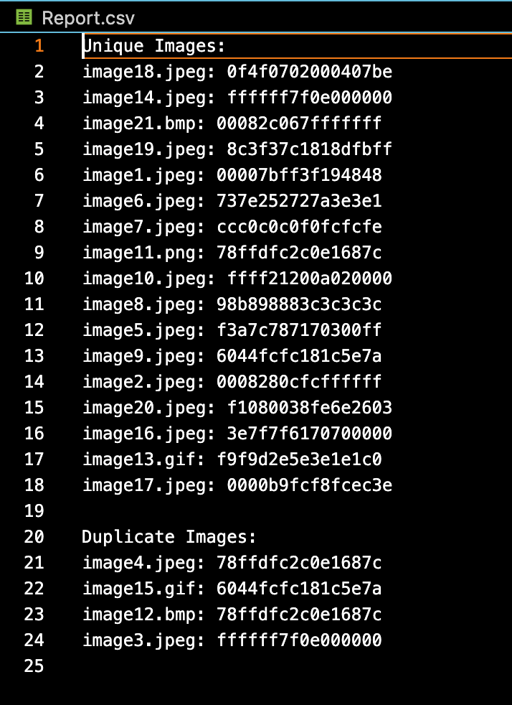
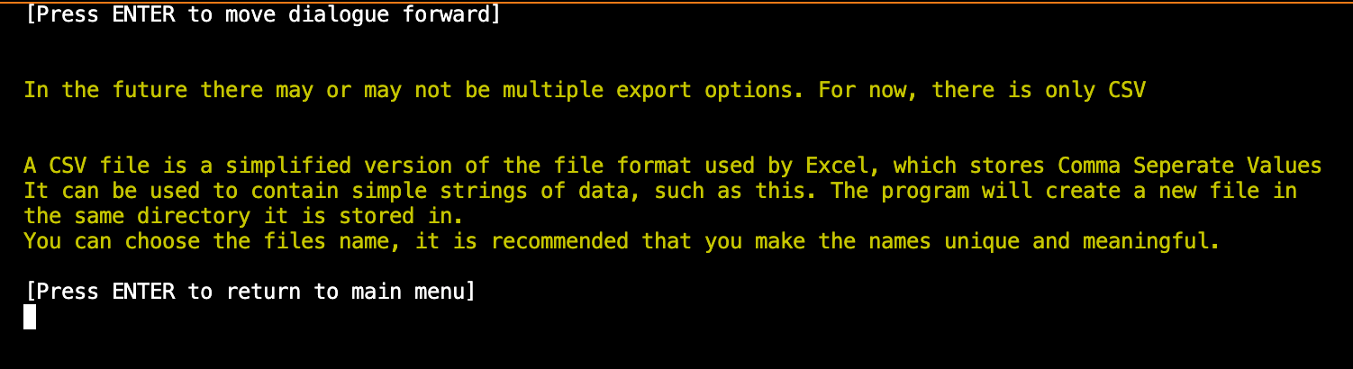
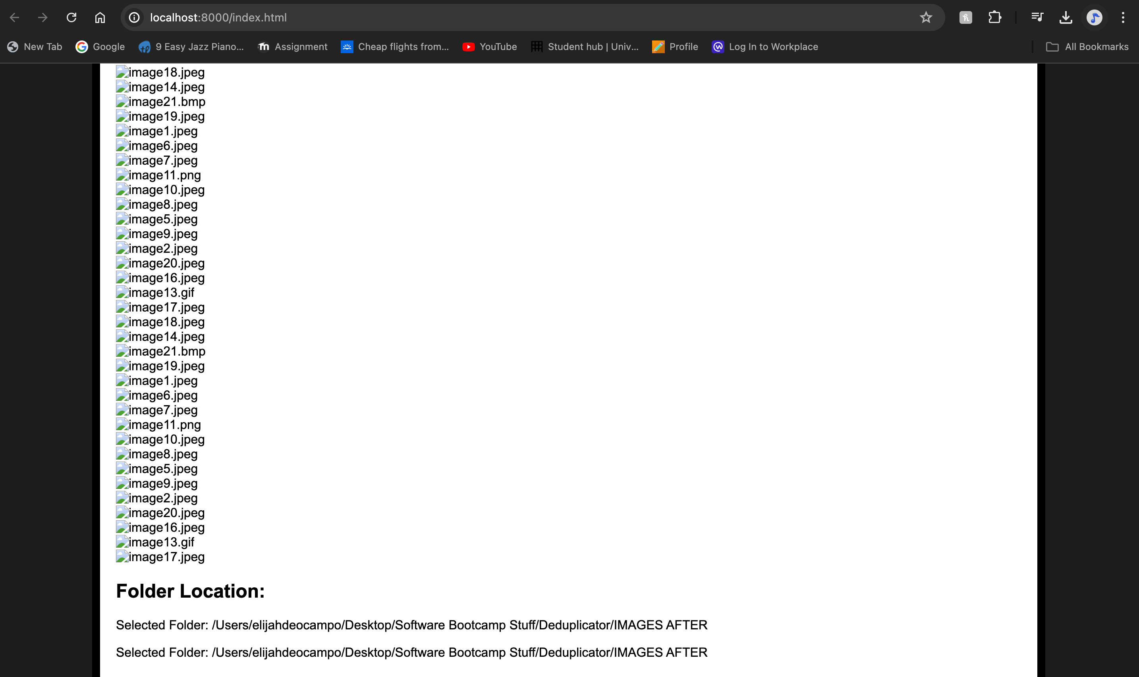
Option '3' will clear the history of the program. As specified in Option '0' (what does it do), this option should be inputted when the user wants to run the program on another file.
Option '4' is the where the export function is. When inputted, the user will be taken to another menu with different options. Option '0' will take the user to a section that explains what the different options do. This being a prototype, it currently has two working options which creates a report either in a CSV file within the program or on a HTML page. Option '4' will return to the main menu.
Option '0' (Info)
Option '2' (HTML)
Option '1' (CSV)

Slide 16
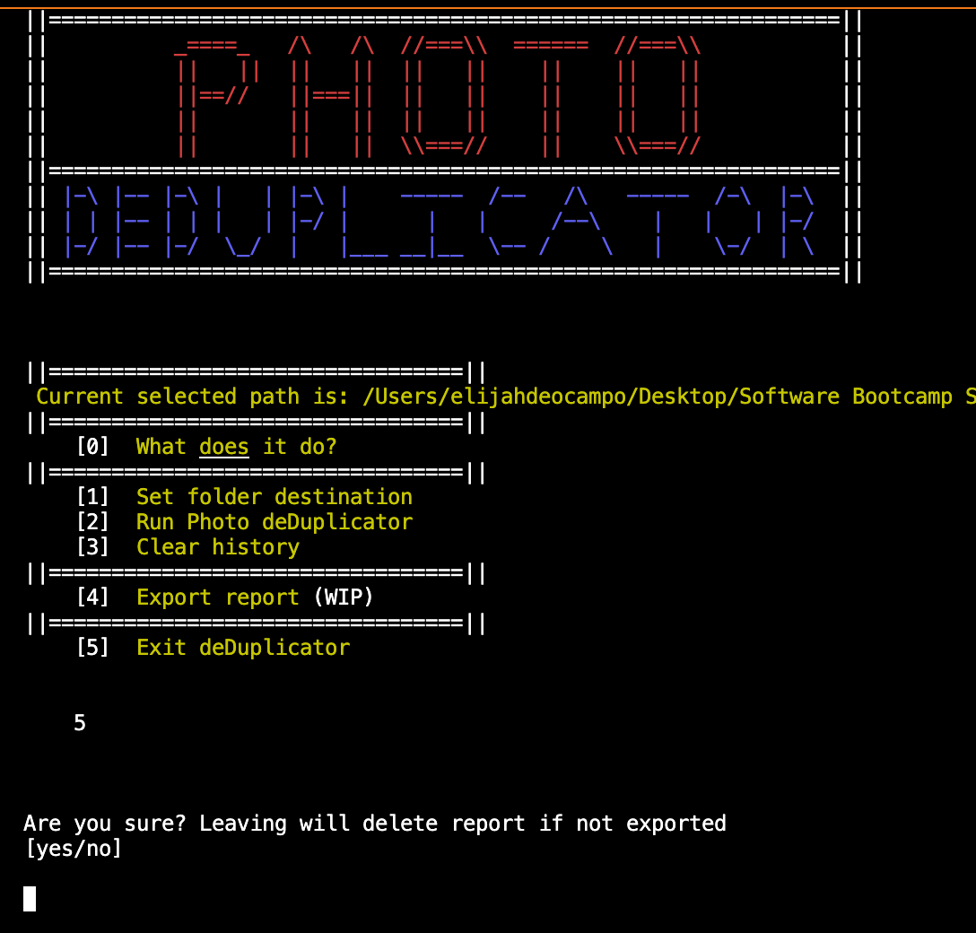
Finally, option '5' will exit the program. Once inputted, the user will be asked if they are sure they would like to exit as if the report has not been exported, it will be deleted.

Slide 17
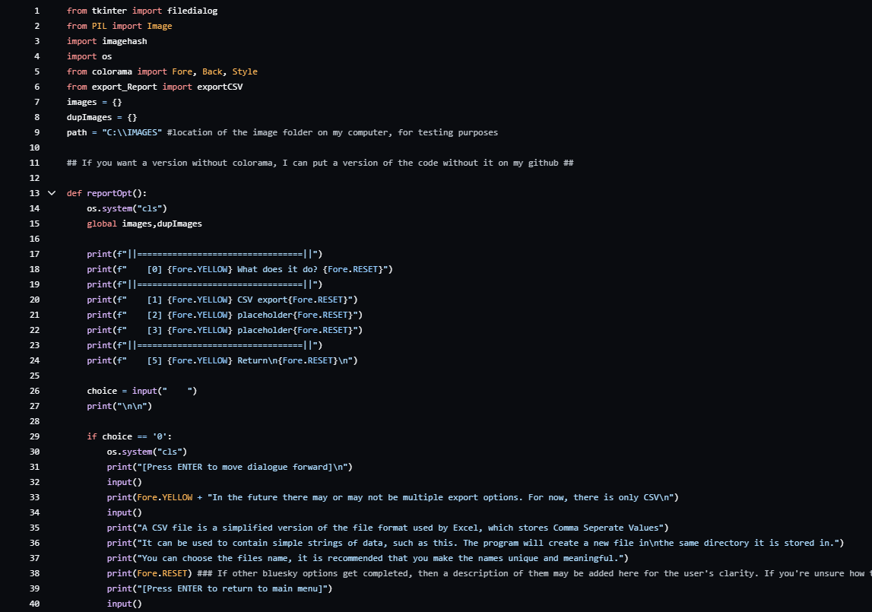
CODE

Slide 18
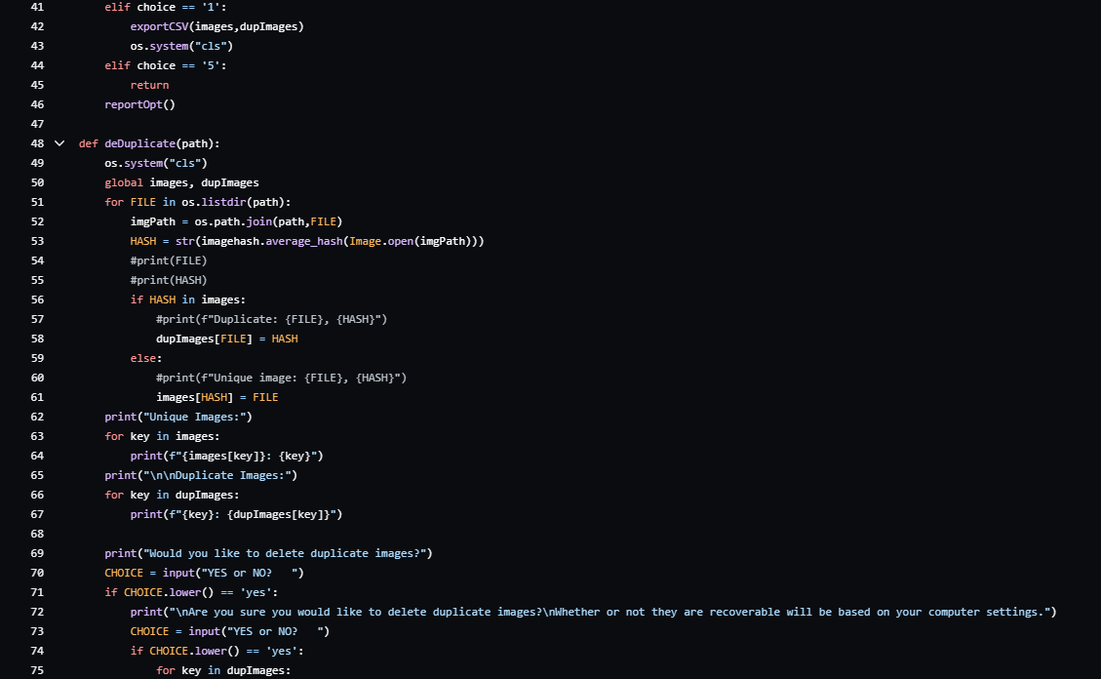
CODE

Slide 19
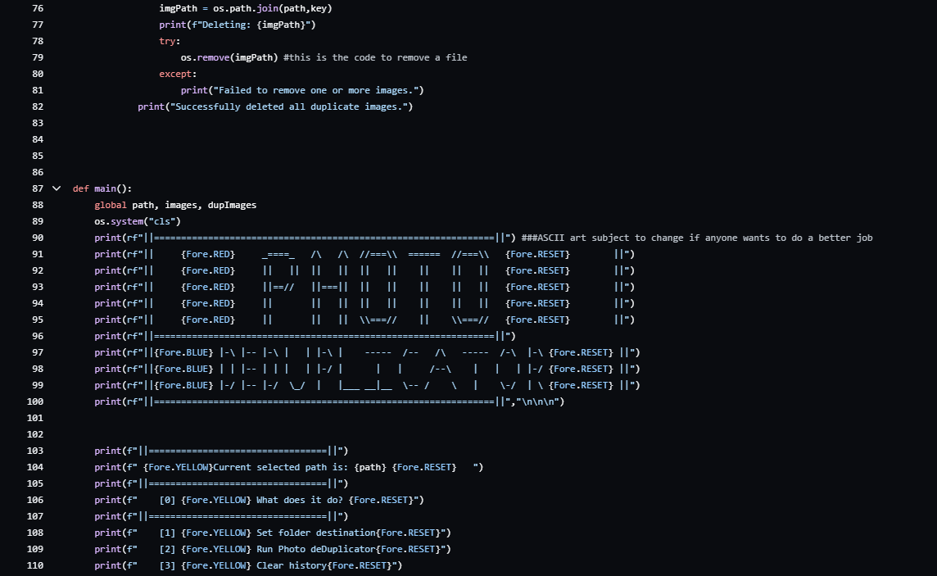
CODE

Slide 20
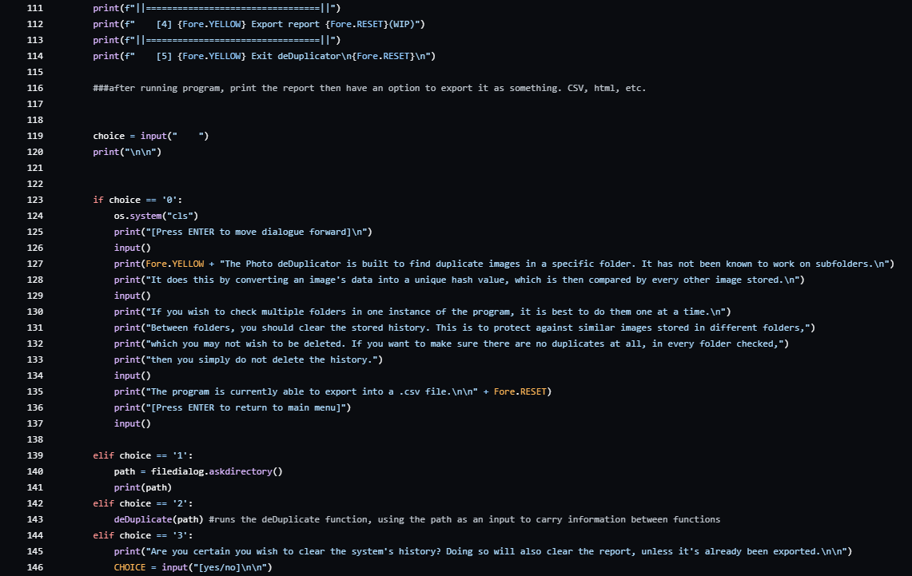
CODE

Slide 21
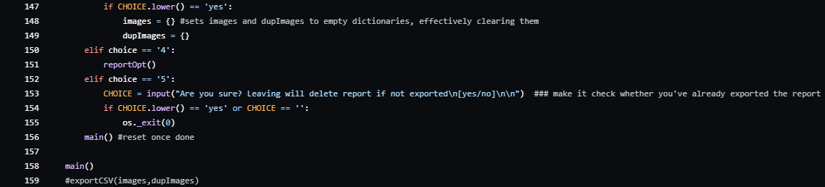
CODE

Slide 22
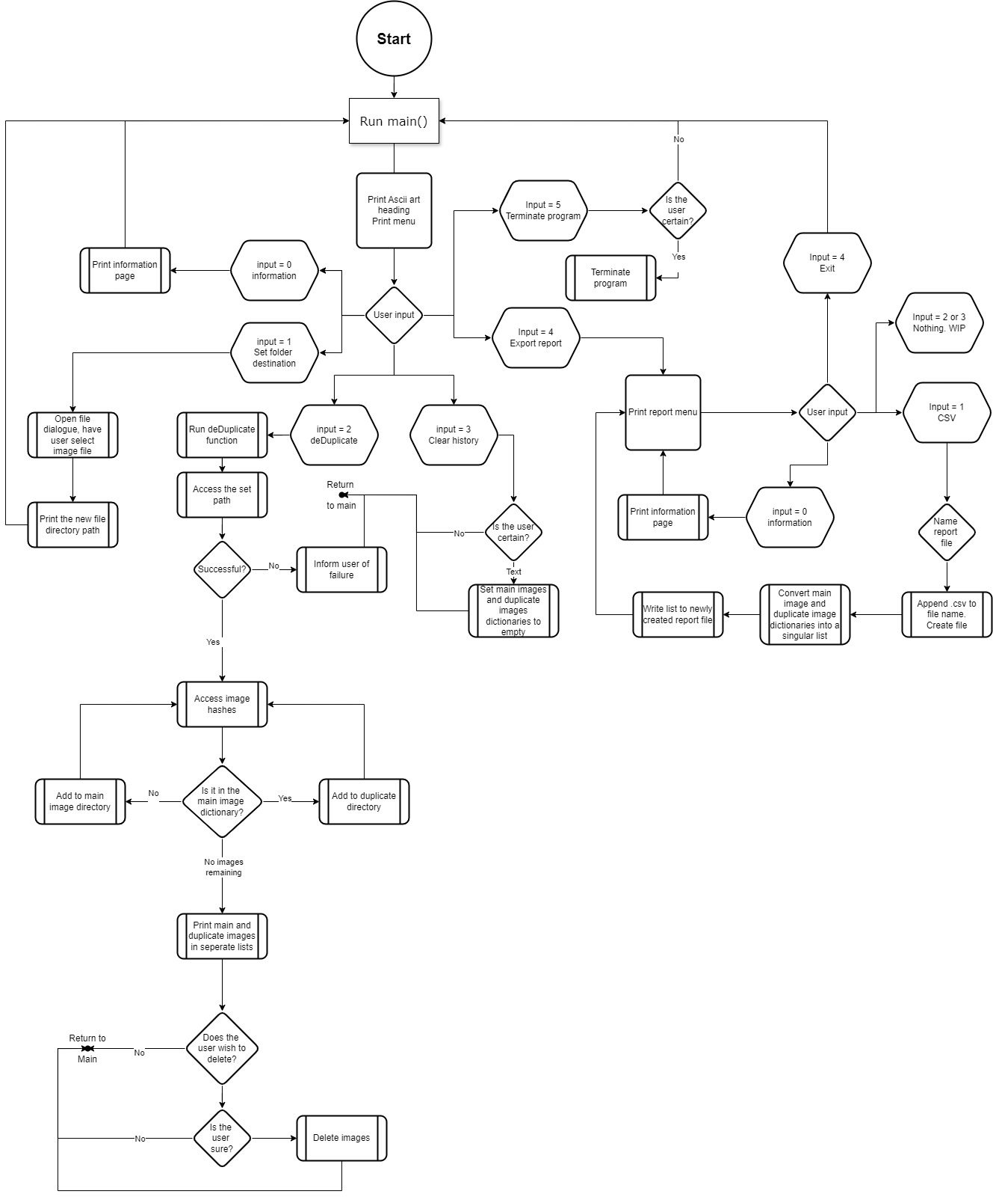
PYTHON CODE IMPLEMENTATION

Slide 23
TESTING
Test Case ID | Test Case Description | Test Data | Expected Result | Pass/Fail | Correction Plan
TC – 01 | Test ‘path’ location | Add folder path | Display folder location and all items in location. | PASS
TC – 02 | Test De-Duplication functionality with images in python | Add folder path that holds unique and duplicated images | Display a list of all images and separate list of duplicates found. | PASS
TC – 03 | Test ‘path’ location if path is empty or does not exist | Add a non-existent path location | Display error message ‘path not found’ | PASS
TC – 04 | Test functionality with different image formats | Add folder path that holds various image formats | Display images even if in different formats without errors. | PASS
TC – 05 | Test user interface to ensure instructions are clear | Try running on different screen sizes and resolutions | Ensure it is all positioned well, readable and easy to follow | PASS
TC – 06 | Test operating system cross-compatibility | Try running on Windows and MAC operating systems | Ensure runs well on both operating systems | PASS
TC – 07

Slide 24

Thank you
Completing our final project wouldn’t have been possible without the dedication, support, and hard work of this incredible group. Thank you all!
To our cohort - it has been an absolute pleasure working alongside each of you. You made these 13 weeks of intense effort truly enjoyable. Hope our paths cross again soon!
To John – our deepest gratitude goes to you! You’ve shared years of knowledge in such a short period and pushed us beyond what we thought we could achieve. We leave this bootcamp feeling confident and prepared for any challenge, thanks to your countless hours of guidance and support. You truly are an amazing tutor, and we are all very fortunate to have met you!

